Slide 1
Machine Learning for data science and business intelligence – 8IAR403
By Kévin Bouchard Ph.D.
Professor in artificial intelligence & machine learning
Laboratoire d'Intelligence Ambiante pour la reconnaissance d'activités (LIARA)
Université du Québec à Chicoutimi
www.Kevin-Bouchard.ca

Slide 2

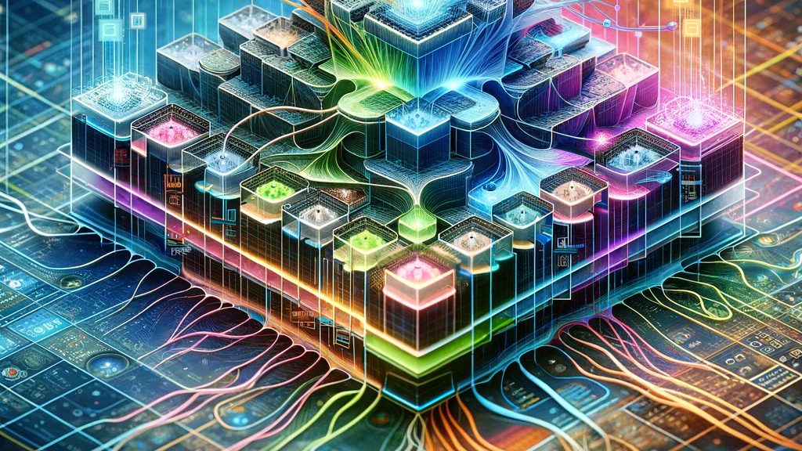

Summary of lesson #19
You will learn about:
A classic machine learning problem
A specific type of more advanced neural net called a convolutional neural network
About pooling, dropout, transfer learning and other tricks to help in your task

Slide 3
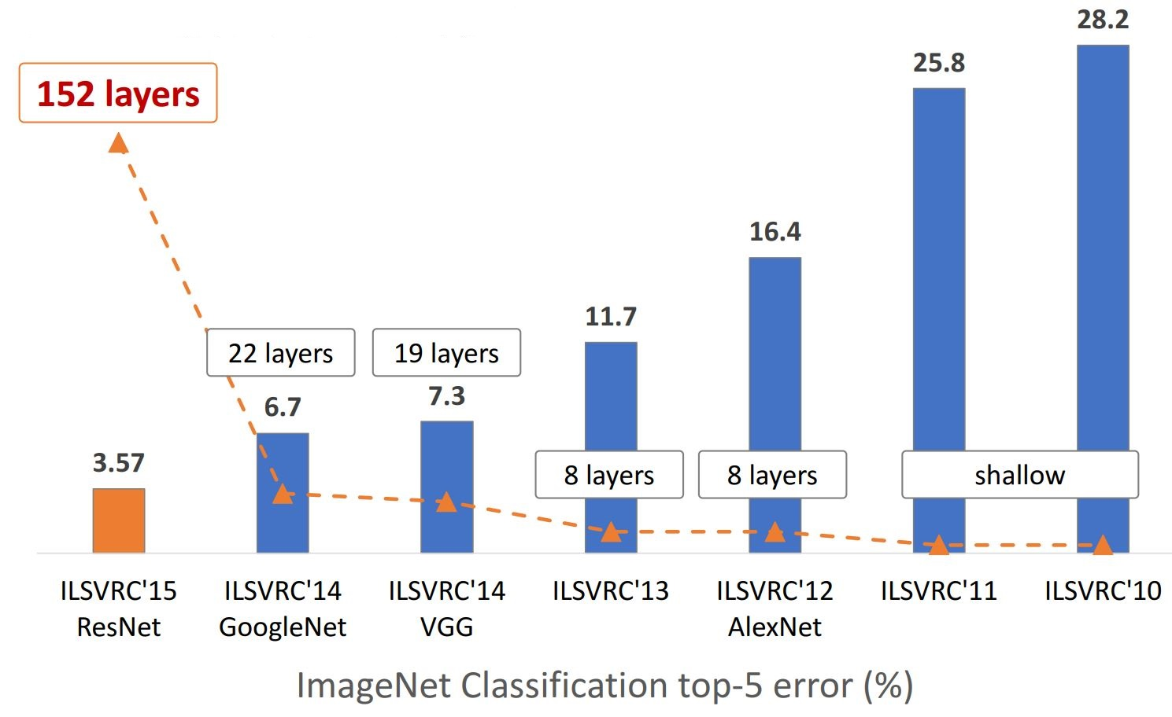
ImageNET
Large Scale Visual Recognition Challenge
Notes:
Erreur Top 5

Slide 4
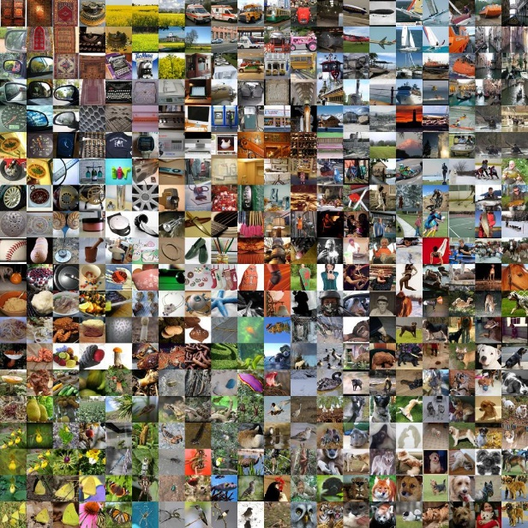
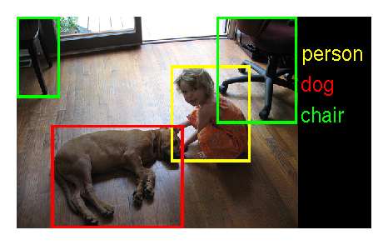
ImageNET
https://www.image-net.org/challenges/LSVRC/2017/index.php
Objects classification
1.2 million images with labels
Objects detection with 200 labeled categories
Objects detection in videos with 30 labeled categories

Slide 5
Convolutional Neural Network
A particular type of neural network that uses convolutions as operations instead of matrix multiplication operations
Not necessarily at every level!
Very useful for data that has a grid-like topology (sounds, images, time series)
We will start with a brief introduction to the convolution operation

Slide 6
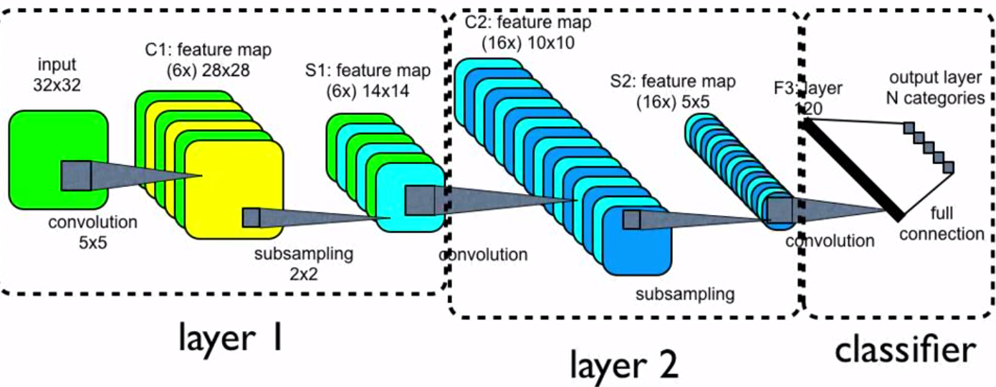
Architecture
A CNN is actually a deep network architecture based on a few types of crucial blocks
This assembly can be complicated
Nevertheless, individually, each block is relatively simple

Slide 7
Basic operations
Convolution (which we will see in the next screens)
Similar to matrix multiplication
Takes an input, produces an output (hidden layer)
Deconvolution (out of our scope)
Similar to multiplication by the transpose of a matrix
Used for backpropagating the error from outputs to inputs
Calculation of weight gradients (out of our scope)
For backpropagating the error from the outputs to the weights
Takes into account parameter sharing

Slide 8
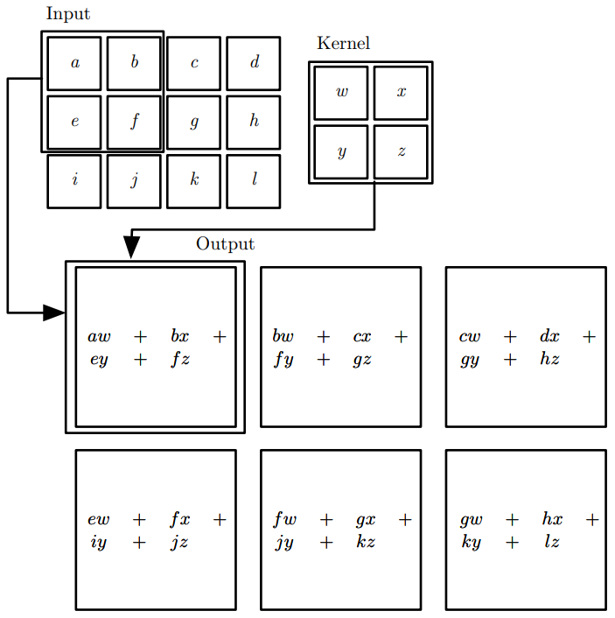


Convolution
Convolution
1 | 0 | 1
0 | 1 | 0
1 | 0 | 1
*
Kernel

Slide 9
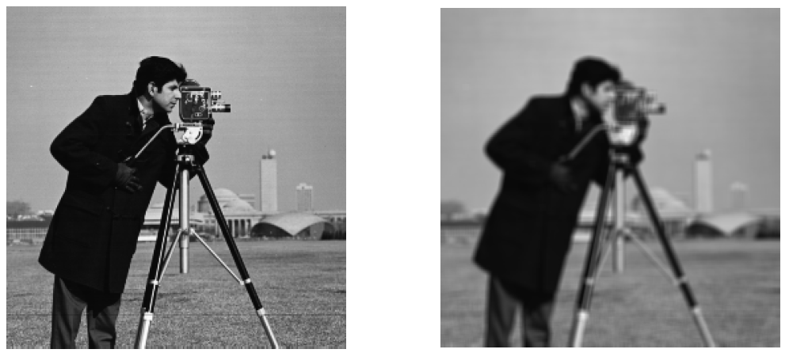
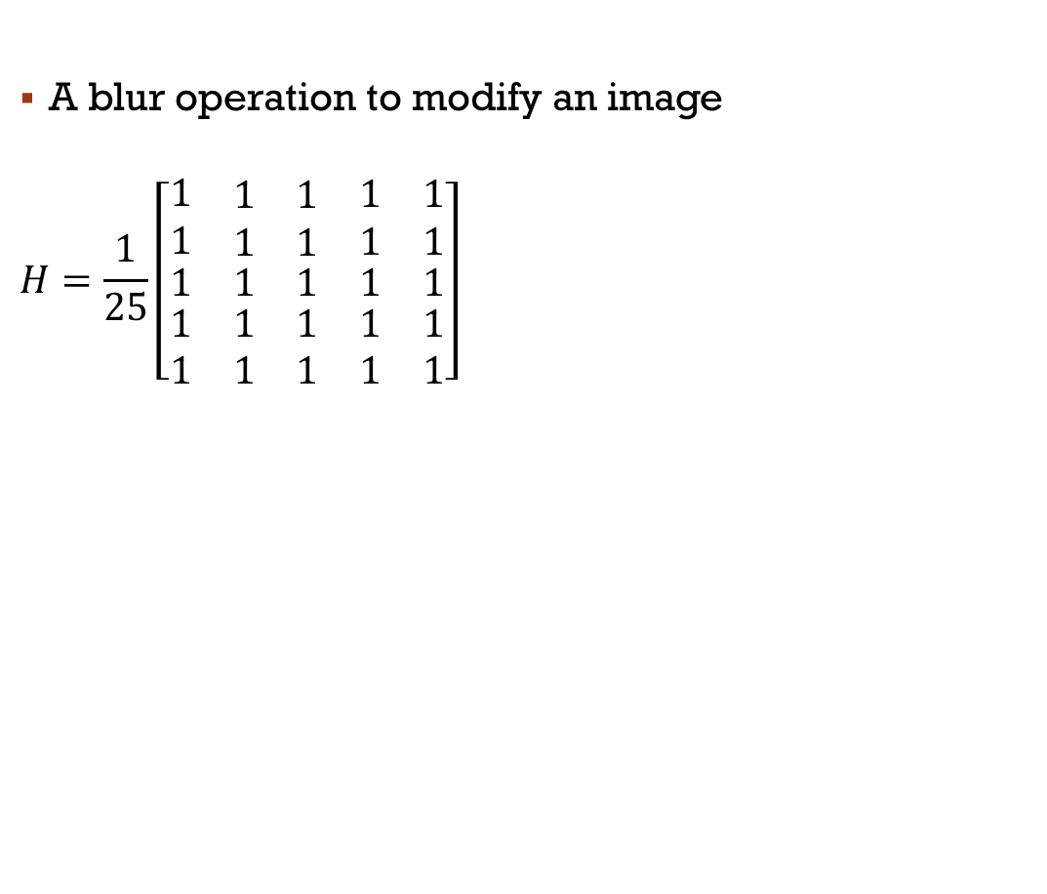
Example
A blur operation to modify an image
$$H=\frac{1}{25}\left[\begin{matrix}\begin{matrix}\begin{matrix}1 & \begin{matrix}1 & 1\end{matrix}\end{matrix} \\ \begin{matrix}1 & \begin{matrix}1 & 1\end{matrix}\end{matrix}\end{matrix} & \begin{matrix}\begin{matrix}1 & 1\end{matrix} \\ \begin{matrix}1 & 1\end{matrix}\end{matrix} \\ \begin{matrix}\begin{matrix}1 \\ \begin{matrix}1 \\ 1\end{matrix}\end{matrix} & \begin{matrix}\begin{matrix}1 \\ \begin{matrix}1 \\ 1\end{matrix}\end{matrix} & \begin{matrix}1 \\ \begin{matrix}1 \\ 1\end{matrix}\end{matrix}\end{matrix}\end{matrix} & \begin{matrix}\begin{matrix}1 \\ \begin{matrix}1 \\ 1\end{matrix}\end{matrix} & \begin{matrix}1 \\ \begin{matrix}1 \\ 1\end{matrix}\end{matrix}\end{matrix}\end{matrix}\right]$$

Slide 10
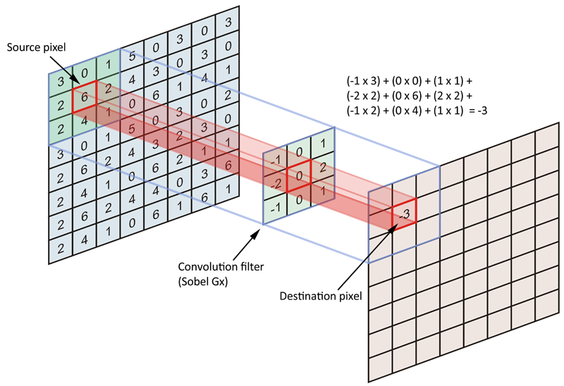
Convolution
In general, we use odd-sized kernels
In ML, it's less damaging
We can even skip some pixels with the 'Stride'
The advantage of convolutions vs. matrix multiplications of standard multilayer networks: local connectivity!
E.g.: An image 32x32x3 colors = 3072. A single hidden neuron would have 3072 weights to learn.
Convolutions can also work with variable input sizes!
To take advantage, use kernels smaller than the input!

Slide 11
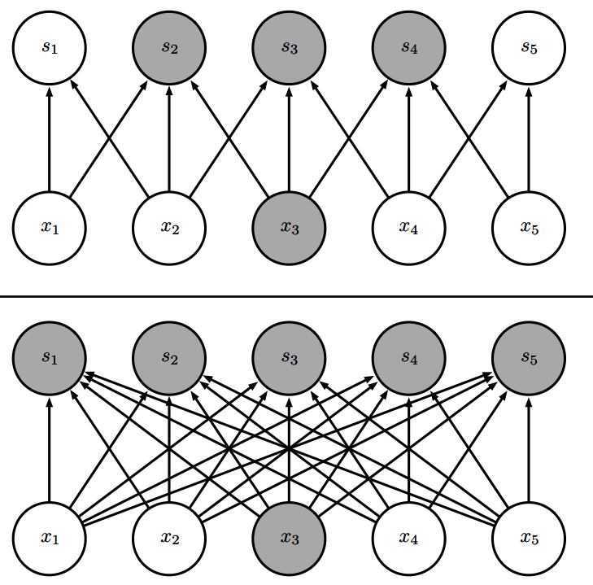
Connectivity
Compared to a dense network, we have only a few connections between neurons.
They are locally connected!
It helps in focusing on spatial information
Notes:
Expliquer biais… moins important dans conv.

Slide 12

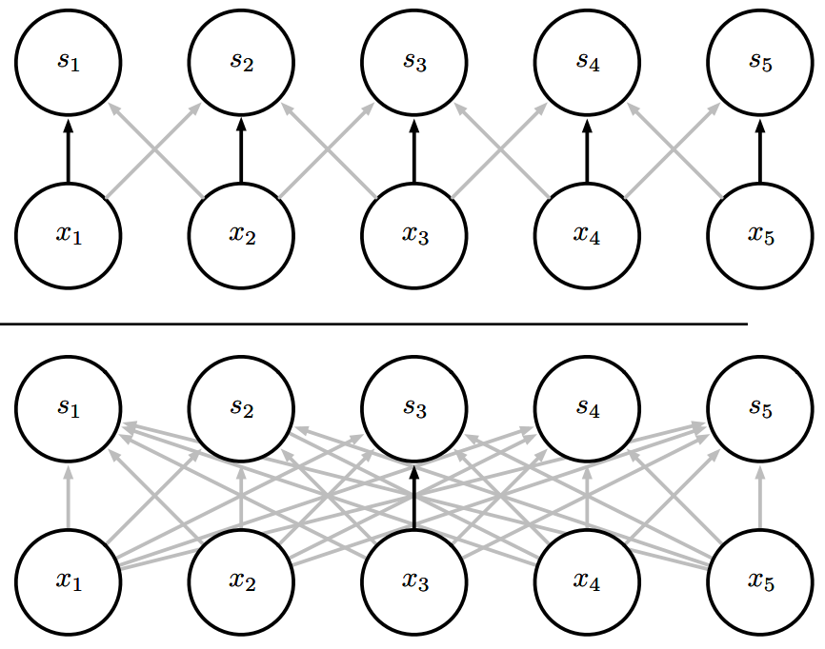
Weight sharing
In a traditional matrix multiplication, each weight of the matrix 𝑊 is used only once.
In a CNN, the weights of a kernel are used across all inputs.
Instead of learning different weights for each input, we learn only one set.
Notes:
M les entrées de poids

Slide 13
Pooling
Another basic building block of CNNs
Generally, a convolutional layer involves applying many convolutions in parallel
Then, it goes through a non-linear activation layer similarly to previous models (ReLU)
The following layer, pooling, modifies the output
This layer replaces the outputs using summary statistics

Slide 14
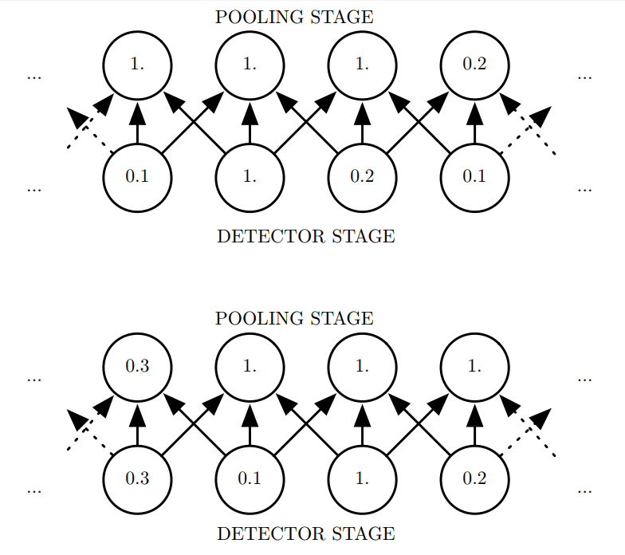
Pooling
Pooling serves to make the representation slightly variable to small changes in the input layer
E.g.: a small translation of the same image should not affect the outputs of the pooling layer
For example, Max Pooling allows taking the maximum value in a neighborhood rectangle
Here, a simplified example with one pixel offset
Notes:
Exemple de caractéristique visages (yeux)

Slide 15
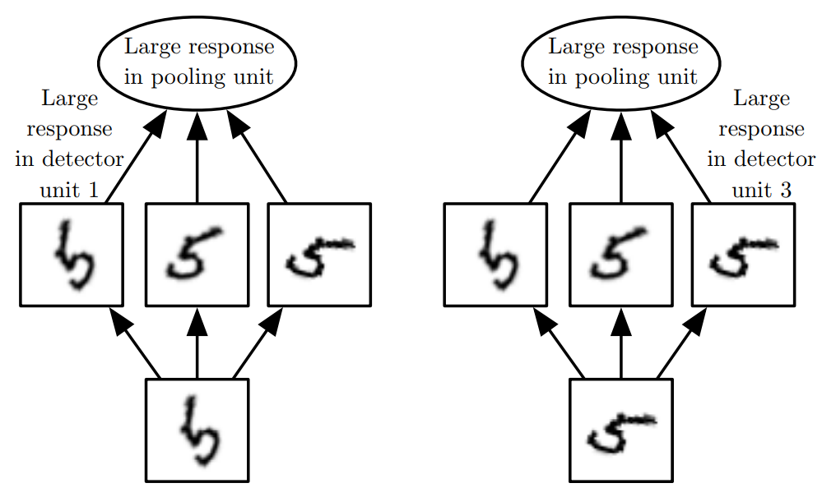
Pooling
Pooling significantly improves the quality of learning
Pooling over a spatial region reduces variations due to translations
Pooling can also be used directly on the outputs of convolutions:
→Three filters learnt to detect various rotation of the number 5
→Max Pooling
Notes:
Average pooling

Slide 16
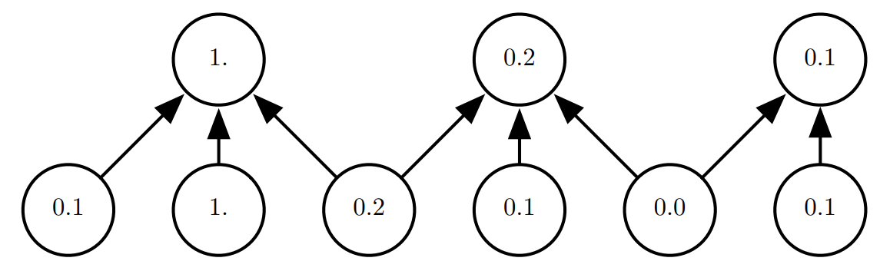
Pooling
There may be fewer pooling units than convolutional units
The summary can be calculated for regions k pixels apart
The next layer therefore has (approximately) k times fewer inputs to manage!
This technique is called pooling with downsampling
Downsampling can be directly done by convolutions!!!

Slide 17
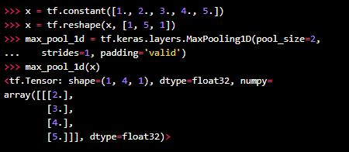
Keras
Keras offers MaxPooling, AveragePooling
But also global max and average
These apply to the entire input
GlobalMaxPooling1D in the example would give 5

Slide 18
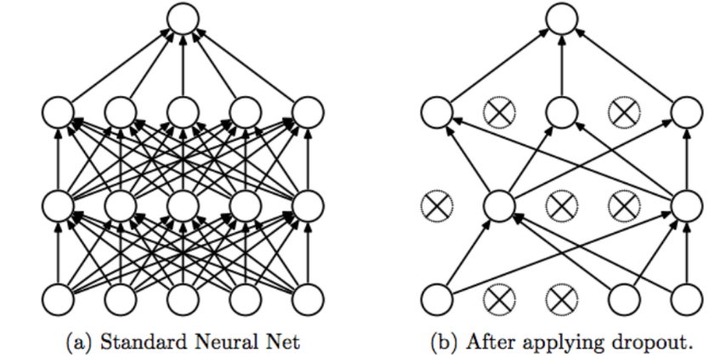
Dropout
Sometimes we can ignore certain artificial neurons
We choose them randomly!
for each hidden layer, for each instance, ignore p units (activations)
Why do we want to do this?
To prevent overfitting
In dense layers, neurons are fully connected and develop co-dependency!
Notes:
+long converger
+robuste

Slide 19
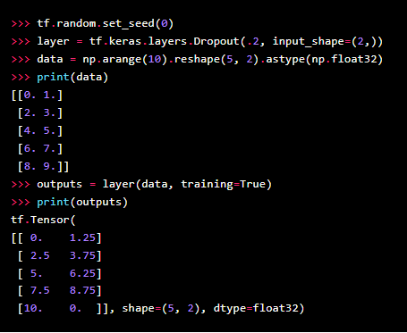
Dropout
It is actually an application of Bagging to a DNN
We generally deactivate 20-50% of hidden units randomly
And sometimes 20% of inputs for each mini-batch
The major difference with bagging is that the models are not independent of each other

Slide 20




Padding and Stride
Stride and padding
No padding
No stride
With stride
No padding

Slide 21
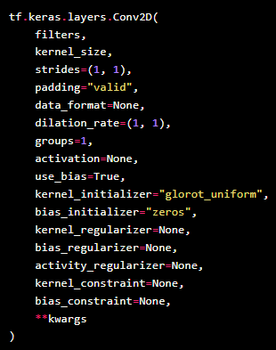
MNIST Example with a CNN
See: https://colab.research.google.com/github/keras-team/keras-io/blob/master/examples/vision/ipynb/mnist_convnet.ipynb#scrollTo=nNhapcvdZb4u
Number of conv.
Size (3x3, 5x5, 7x7)
Valid=without, Same=with
True/False->no bias
Notes:
Pas de biais-> dans les archictectures complexes (surtout CNN), ça a peu d’impact!

Slide 22
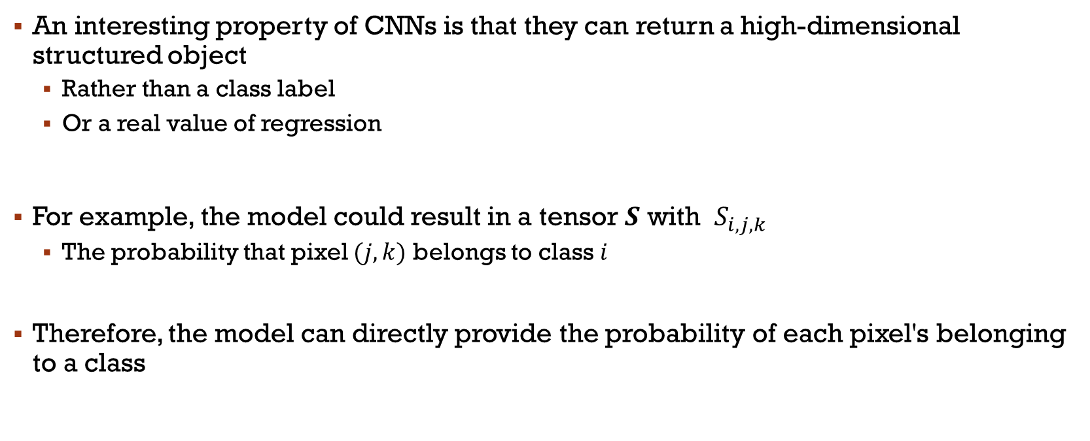
Output as a structure
An interesting property of CNNs is that they can return a high-dimensional structured object
Rather than a class label
Or a real value of regression
For example, the model could result in a tensor $S$ with $S_{i,j,k}$
The probability that pixel $(j,k)$ belongs to class $i$
Therefore, the model can directly provide the probability of each pixel's belonging to a class

Slide 23
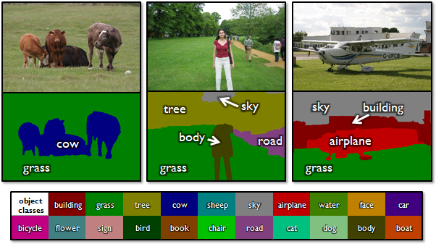
Output as a structure
This particular property allows the CNN to draw precise masks that follow the shape of specific objects in an image.
Notes:
Dire que celui-ci n’est pas le meilleur…

Slide 24
Output as a structure
This task is called image segmentation
Models that have been very successful are R-CNN (several variants)
Can be built directly on VGG, ResNet, etc.
Otherwise directly in FCN (see UNET)
One of the challenges is that the output may be smaller than the input
Cause: pooling with stride and/or convolution without padding
Possible strategies:
Avoid pooling layers
Use pooling to estimate the missing pixels
Iteratively improve the prediction of pixels by recurrence
Notes:
CNN recurrent
Fully Convoluted Network (pas de dense)
C’est devenu populaire en vision artificielle pour la segmentation

Slide 25
Data type supported
 | One chanel | Multiple chanel
1D | Audio signal: Signal amplitude over time (discrete). Convolution over time. | Animation data: Animations of a character through various positions of a 'skeleton' over time. At each moment, the character is described by the angles of each joint.
2D | Audio Fourier: Transformation into 2D data with FFT. Columns: Frequencies. Rows: points in time. | Color image: One channel per color. Matrix of intensities corresponding to each pixel in the image.
3D | Volumetric data: Medical imaging, for example, computed tomography (CT scan). | Color video: Same as the image, but with an additional axis for time.
Notes:
Audio processé avec fourier

Slide 26
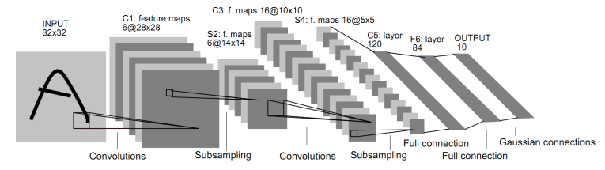
Example of architecture
LENET
Convolution, downsampling, backpropagation
Notes:
S2-pooling
Code à voir rapidement…

Slide 27
VGG
At the announcement of the ILSVRC 2014 results
A simple architecture (yet very deep at the time!)
Convolutions 3x3
5 layers of MaxPooling
3 layers of dense neurons
2-3 weeks to train on 4 GPU
Notes:
Compte pas les pooling & soft

Slide 28
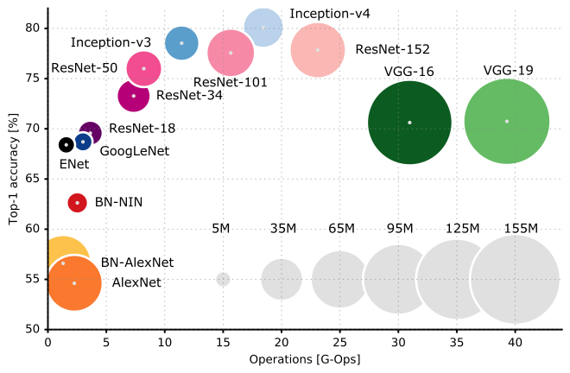
Notes:
Resnet +++ gros! Parler brièvement de parallélisation sur TPU ou GPU…

Slide 29
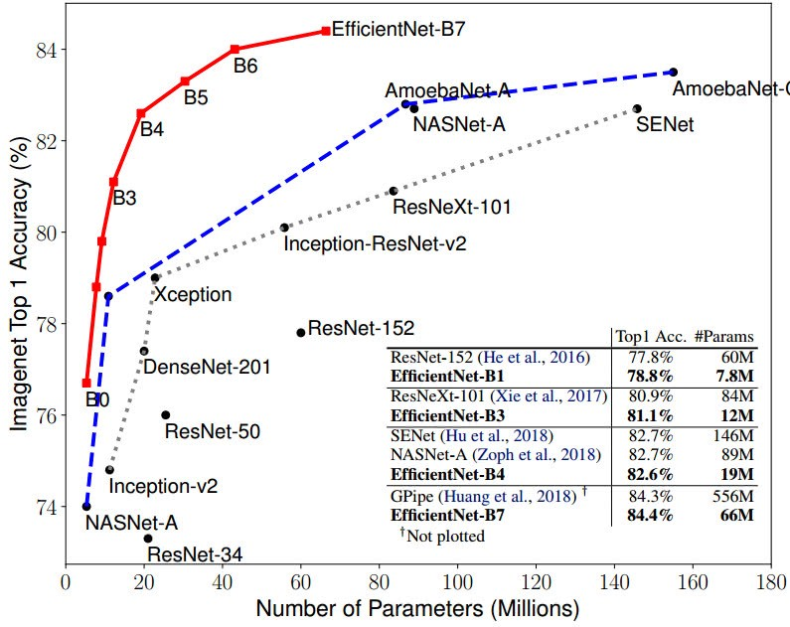
A bit more recently
To keep up…
https://paperswithcode.com/sota/image-classification-on-imagenet

Slide 30
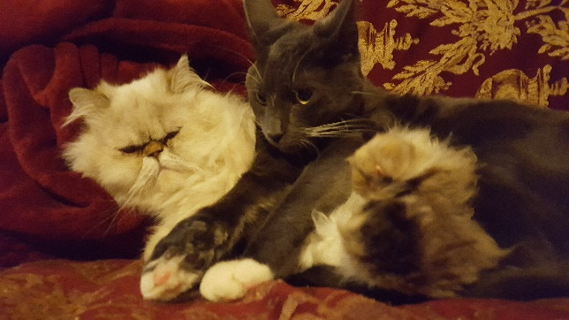
Other things to know?
Data augmentation:
Parallelization: CNNs can be implemented to run on GPUs. They can also run on specific hardware.
Transfer learning: Nowaday, most of the time, you don’t train a CNN from scratch. You transfer the parameter learnt on a a similar task and fine tune them!
…

Slide 31
Main References
Russell S., Norvig P., Artificial Intelligence: A Modern Approach. Prentice-Hall, Englewood Cliffs, 2021.
Aggarwal, C. C., Neural networks and deep learning. Springer, 2023.
Goodfellow I., Bengio Y., Deep Learning. The MIT Press, 2016.
Raschka S., Python Machine Learning, Packt Publishing, 2015.
Sutton R.S., Barto A.G., Reinforcement Learning: An Introduction, A Bradford Book, 2021.
Witten I.H., Frank E., Hall M.A., Pal C. Data Mining: Practical Machine Learning Tools and Techniques, Morgan Kaufmann, 2016.

